Slide 1

Bright Coffee Shop
BRIGHT
COFFEE SHOP
BY: VHONANI MPHOSHOMALE
(DATA ANALYTICS)

Slide 2


Bright Coffee Shop
OVERVIEW
Purpose
This analysis evaluates sales performance across products, time periods, and store locations.
LOCATIONS:
Lower Manhattan
Hell’s Kitchen
Astoria
Duration of Dataset:
6 months
01/01/2023 - 30/06/2023
Total Revenue:
R698 812.33
Total Transactions:
149 116
Total quantitty sold:
214 470

Slide 3


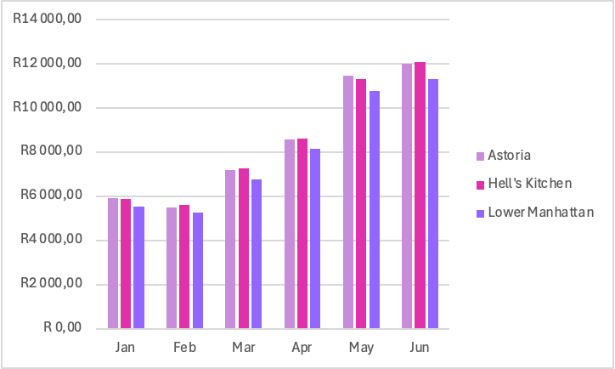
Bright Coffee Shop
REVENUE TRENDS BY MONTHS & LOCATION
Revenue is noticeably lower in the first two months (January and February), followed by a steady increase from March through June, with June recording the highest performance. Across all six months, Hell’s Kitchen slightly outperforms Astoria, while Lower Manhattan consistently generates the lowest revenue.

Slide 4

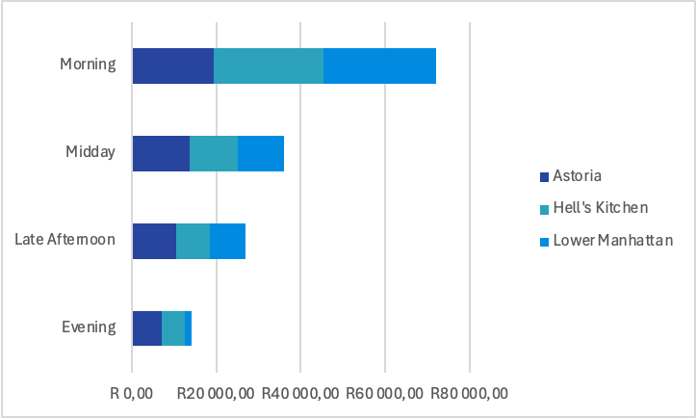
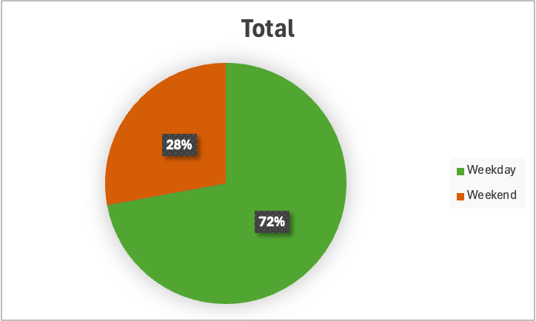
Bright Coffee Shop
TIME BEHAVIOUR
Time of day perfomane
Weekday VS Weekend `perfomance
Weekday revenue (R107k) is more than double weekend revenue (R41k), indicating that the business is heavily dependent on weekday customer traffic
The morning period generates the highest revenue by a significant margin, contributing nearly half of total sales. Midday and late afternoon show moderate performance, while evening sales are substantially lower across all locations

Slide 5

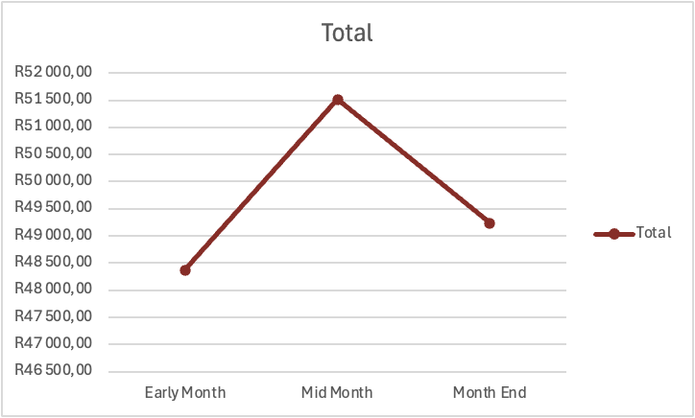
MONTH PERIOD TREND
Bright Coffee Shop
Revenue increases progressively throughout the month, with the highest sales recorded at Mid-month, suggesting that customer spending is strongest during the month.

Slide 6

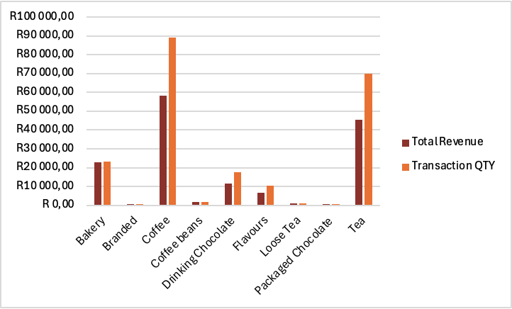
Bright Coffee Shop
PRODUCT CATEGORY INSIGHTS
Coffee is the top-performing category in both revenue and quantity, followed by tea, while bakery contributes moderately. All other categories generate significantly lower revenue, indicating a strong reliance on a few key product groups

Slide 7

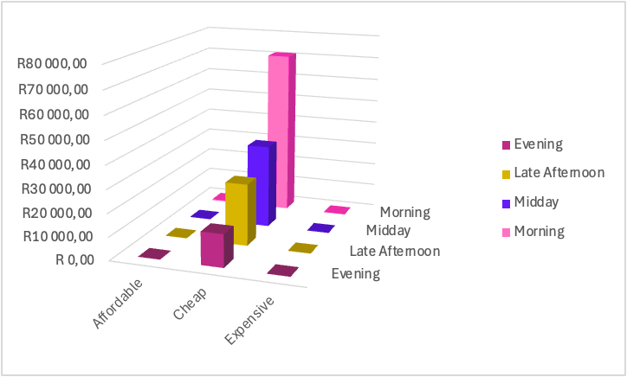
CUSTOMER SPENDING BEHAVIOUR
By Time of Day
Bright Coffee Shop
Across all time periods, the majority of revenue is generated from low-priced items, with morning sales showing the highest contribution within this category, reinforcing the dominance of high-volume, low-cost purchases

Slide 8

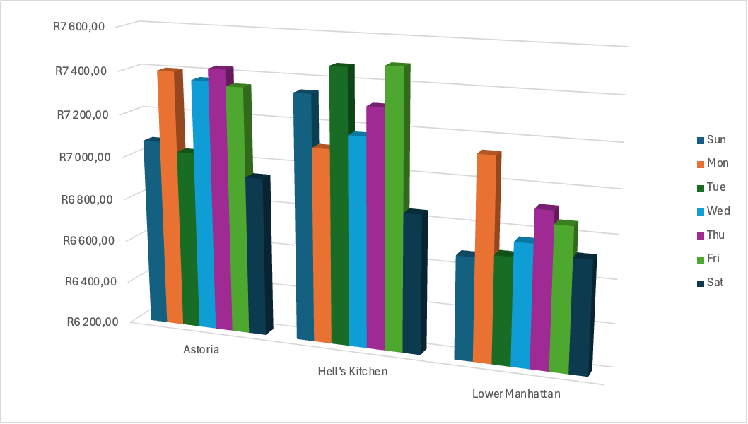
Bright Coffee Shop
LOCATION VS DAY OF WEEK
Revenue remains relatively consistent across all days of the week, with a slight peak on Fridays and a minor decline on Saturdays, indicating stable daily demand with small end-of-week variations.

Slide 9

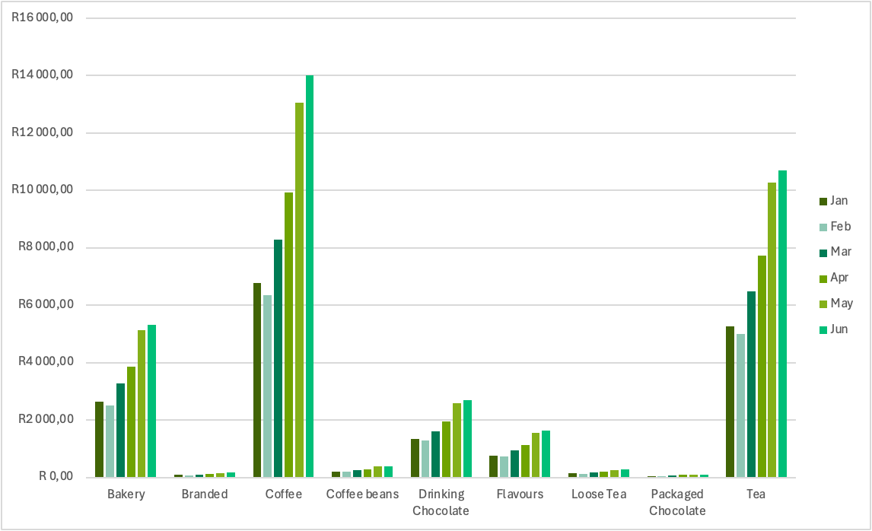
Bright Coffee Shop
SEASONAL TRENDS
All product categories show consistent growth over time, with the most significant increases occurring from March onwards. Coffee and tea remain the dominant contributors throughout all months

Slide 10

Bright Coffee Shop
Overall, sales performance is driven by strong morning demand, high reliance on weekday traffic, and a concentration of revenue within a few key product categories, particularly coffee and tea. Growth trends indicate increasing demand over time, with customers consistently favouring low-priced items
KEY INSIGHTS
RECOMMENDATIONS
Given the strong reliance on morning sales, staffing and operations should be optimized during early hours. The dominance of coffee and tea suggests a need for targeted promotions and product expansion within these categories. Since customers are highly price-sensitive, bundle deals and volume-based pricing strategies could help increase average spend. Additionally, weekend and evening promotions should be introduced to improve performance during slower periods.

Slide 11

Bright Coffee Shop
CONCLUSION
This project shows how raw data can be transformed into useful insights. It demonstrates my ability to clean data, analyse trends, and present findings in a clear and structured way.
It also highlights my growing skills in SQL, data analysis, and problem-solving, and my ability to connect data insights to real business decisions.

Slide 12
Bright Coffee Shop
THANK
YOU

